Slide 1
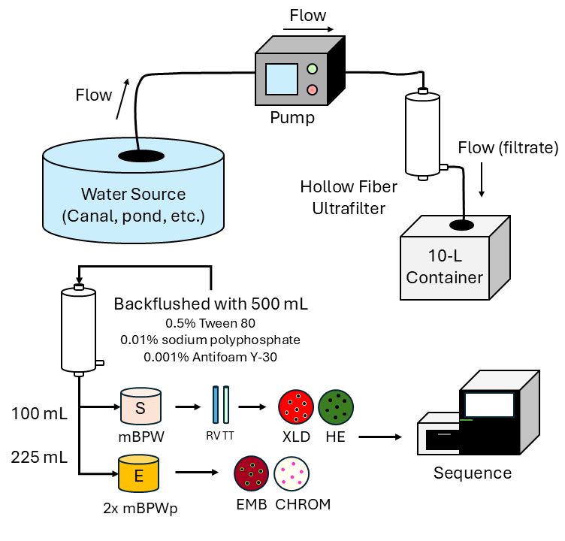
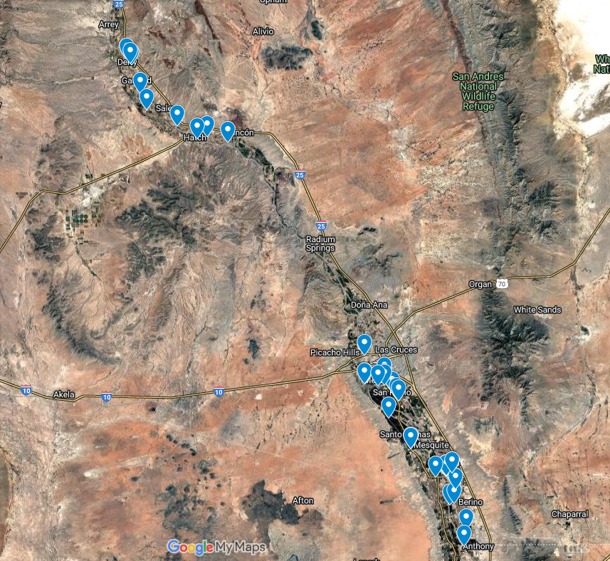
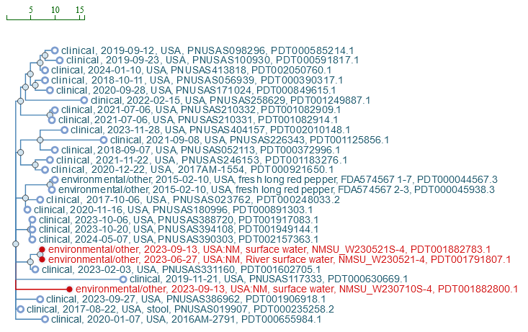
Dead-End Ultrafiltration for Pathogen Detection in Irrigation Water
Yatziri Presmont, Ruben Zapata, and Willis Fedio
New Mexico State University, Food Safety Laboratory, Las Cruces, NM 88003
SUMMARY
MATERIALS AND METHODS
CONCLUSIONS
Introduction: Advancements in microbial detection methods and sample collection systems have improved the ability of identifying foodborne pathogens and illness outbreaks and helped increase the awareness of food safety risks related to agricultural water sources.
Purpose: To use Dead-End Ultrafiltration (DEUF) to concentrate surface water from irrigation water in New Mexico chile growing regions for detection of pathogenic E. coli and Salmonella serovars.
Methods: DEUF was used to concentrate contaminating bacteria in 10-gallon samples of water. The DEUF filters were capped and brought to back the lab where they were backflushed.
Results: Of the 60 water samples that were collected, Salmonella was detected in 50 (83.3 %) and STEC in 2 (3.3%). Whole Genome sequencing of the isolates revealed closely relatedness with public clinical and food isolates.
Significance: The hollow fiber filters employed in the DEUF method were found to be suitable for detection of bacterial pathogens in agricultural water having significantly high amounts of small debris and sediment. This method is useful for microbial analysis in water monitoring and risk assessment, allowing the identification of critical points and potential hazards in water destined for agricultural use.
DEUF was used to concentrate contaminating bacteria in 10 gallons of water. The DEUF filters were capped and brought to back the lab where they were backflushed with 500 ml of 0.5% Tween 80, 0.01% NaPP and 0.001% Antifoam Y-30.
For Salmonella detection, 100 ml of backflush solution were used plus equal volume of Modified Buffered Peptone Water (mBPW) and an incubation period of 24h at 35˚C for further selective enrichment with 10 ml of Tetrathionate (TT) plus 1 ml of enrichment and 10 ml of Rappaport–Vassiliadis (RV) with 0.1 ml of enrichment, both tubes were incubated for 24h at 43˚C and 42˚C respectively. After incubation, the samples were streaked on Xylose Lysine Deoxycholate agar (XLD) and Hektoen enteric agar (HE). Typical colonies were selected for biochemical tests and confirmation by PCR before sequencing.
For EHEC/STEC detection, 225 ml of backflush solution were used plus equal volume of double strength Modified Buffered Peptone Water with Pyruvate (2x mBPWp) and an incubation period of 24h at 35˚C with an addition of Acriflavin-Cefsulodin-Vancomycin (ACV) additives accordingly for 450 ml at the fourth hour. Due to high background levels of microflora in the sample we used Chromogenic agar for E. coli O157 and L-Eosin-Methylene Blue (L-EMB). Typical colonies were selected for biochemical tests and confirmation by PCR before sequencing.
DEUF is a feasible method to monitor pathogenic bacteria in different types of waters.
Salmonella had the highest prevalences in agricultural watersheds used by produce farms and pathogenic E.coli had the lowest.
The serovars found have a history of clinical illnesses and may pose a risk to food safety.
This research highlight the importance of testing the water used for crop irrigation and supports the risk-based regulations for agricultural water.
Figure 1. Experimental flow for DEUF method
Figure 4. Testing locations
INTRODUCTION
RESULTS AND DISCUSSION
REFERENCES
Advancements in microbial detection methods and collection systems have improved the ability of identifying foodborne illness outbreaks and helped increase the awareness of food safety risks related to agricultural water sources as it is well known that it can be a vehicle for foodborne pathogen contamination.
In general, irrigation water is ranked by the risk of microbial contamination hazard, for instance the potable water has the lowest risk, followed by the rainwater, deep groundwater, and finally at the highest risk is the surface water and inadequately treated wastewater.
In recent years, an increasing number of outbreaks and recalls have been related to contaminated produce with pathogenic E. coli and Salmonella, the top leading causes of bacterial foodborne illnesses. Salmonella is frequently present in surface water as reported by surveys done in different regions of the country due to its ability to withstand environmental stress. In contrast, pathogenic E. coli is often attributed to cross-contamination of livestock farming with crops.
In this study we used a Dead-End Ultrafiltration (DEUF) technique to concentrate surface water from irrigation canals located in the New Mexico chile growing regions to detect the presence of pathogenic E. coli and Salmonella to have an overview of their persistence in agricultural water and relatedness with other isolates from public databases.
Of the 60 water samples that were collected, Salmonella was detected in 50 (83.3 %) and STEC in 2 (3.3%). Whole Genome sequencing of the isolates revealed closely relatedness with public clinical and food isolates, especially with Salmonella Newport strains as shown in Figure 2.
Other serovars found were Rubislaw, Javiana, Norwich, Tucson, Newmexico, Muenchen, Oranienburg, Poona, Montevideo, Pomona, Panama, and Idikan.
Gorski Lisa., Liang Anita S., Walker Samarpita., Carychao Diana., Aviles Ashley., Mandrell Robert E., and Cooley Michael B. Salmonella enterica Serovar Diversity, Distribution, and Prevalence in Public-Access Waters from a Central California Coastal Leafy Green-Growing Region from 2011 to 2016. Applied Environmental Microbiology. 2022 Feb 8;88(3):01834-21
Leaman Susan M., Danyluk Michelle D., Rock Channah M., Salas Sonia., Strawn Laura K., Suslow Trevor V., and Davis De Ann. Agricultural Water Use in U.S. Fresh Produce Growing Operations Part I: Pathogen Presence and Persistence. Food Protection Trends. 2024 May/June vol. 44, no. 3 pp. 228-247
Salmonella
ACKNOWLEDGEMENTS
Figure 2. Salmonella Isolates from NCBI
We would like to thank Estevan Alvarez and Clinton Owusu for sample collection, and Adriana Rivas for technical support. We would also like to thank the FDA Laboratory Flexible Funding Model, the New Mexico Chile Pepper Association and the New Mexico Department of Agriculture for financial support.
With respect to E. coli isolates, only two were positive for at least one type of Shiga toxin, but none of the isolates were related to others found in public databases.
Figure 3. Salmonella serovars distribution

